Slide 1
Visual Autoregressive Model
For Image Generation
Jintong Gao
2024.12.12

Slide 2
Visual Autoregressive Model
Visual Autoregressive Model
Visual Autoregressive Model for Image Generation.

Slide 3
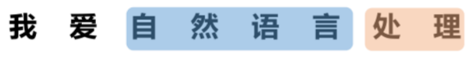
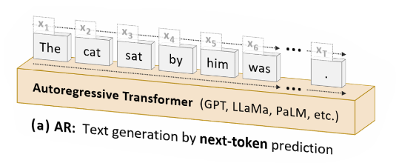
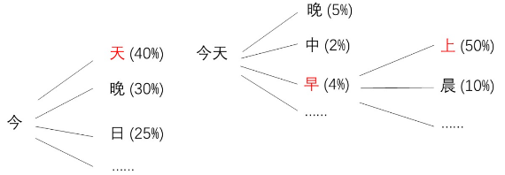
Text Autoregressive Model

Slide 4
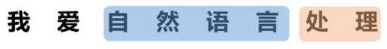
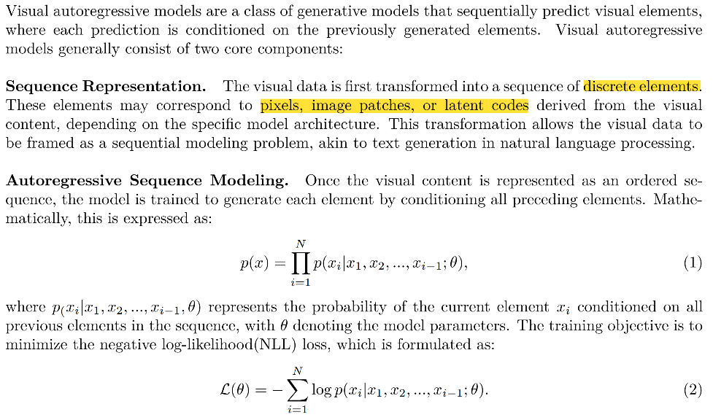
Visual Autoregressive Model

Slide 5
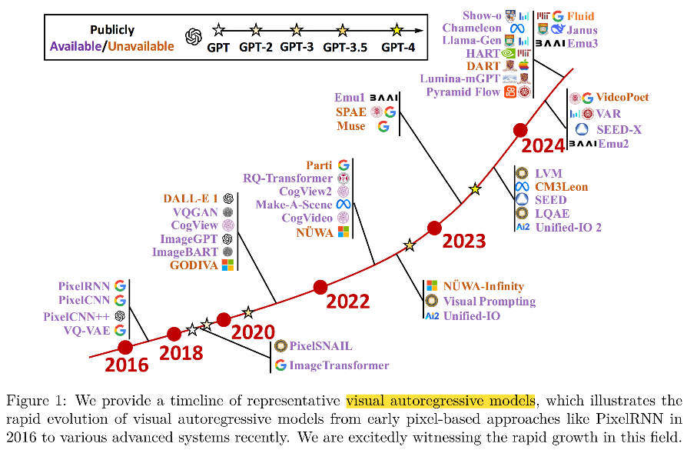
Visual Autoregressive Model

Slide 6
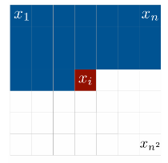
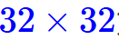
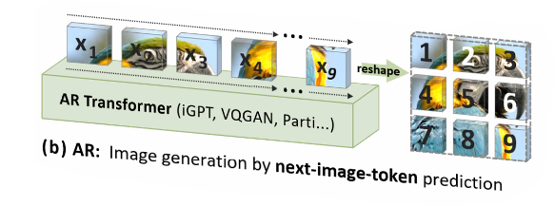
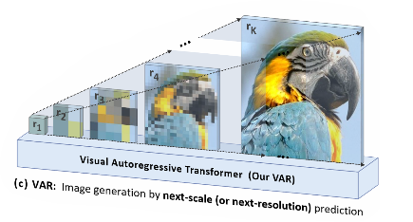
Visual Autoregressive Model
for Image Generation
Pixel-based Models
Token-based Models.
Scale-based Models.

Slide 7
Visual Autoregressive Model
Pixel Recurrent Neural Networks. ICML 2016.
Neural Discrete Representation Learning(VQVAE). NeurIPS 2017.
Visual Autoregressive Modeling: Scalable Image Generation via Next-Scale Prediction.
NeurIPS 2024.

Slide 8
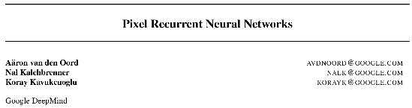
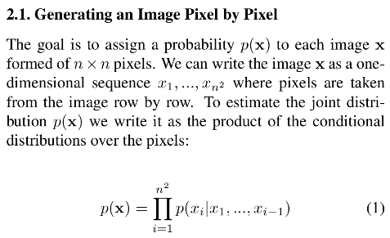
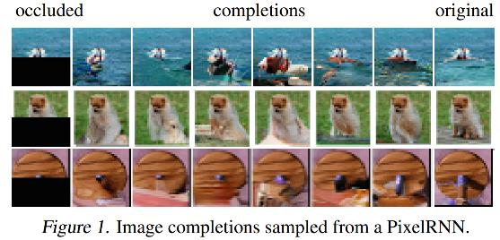
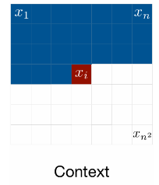
ICML 2016

Slide 9
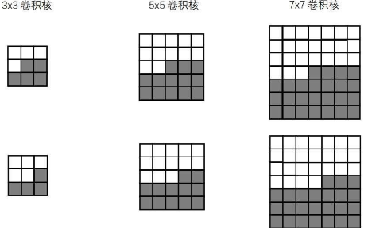
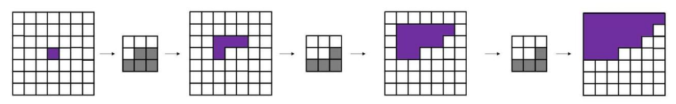
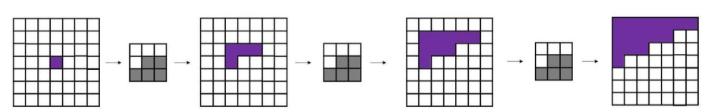
Mask Conv
Mask A
Mask B
Mask A
Mask B
Mask B
True
Mask A
Mask A
Mask A
False

Slide 10
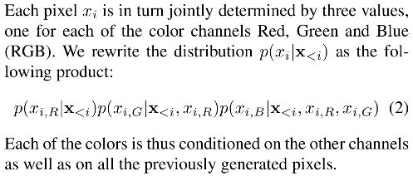
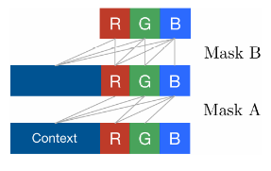
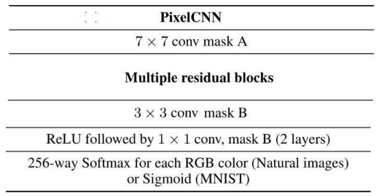
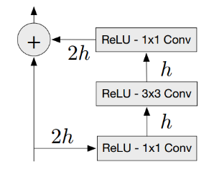
Residual Block

Slide 11
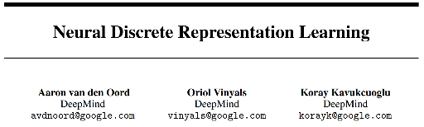
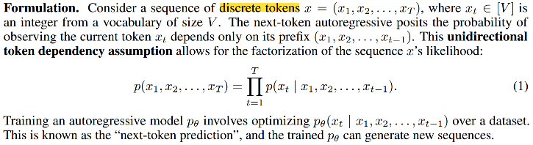

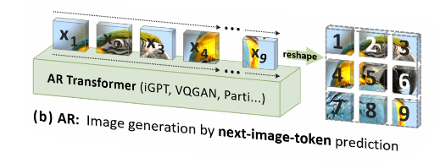
NeurIPS 2017

Slide 12
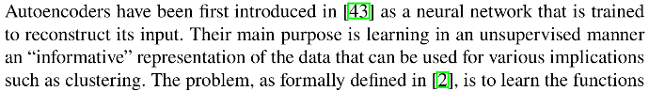
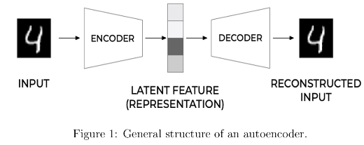
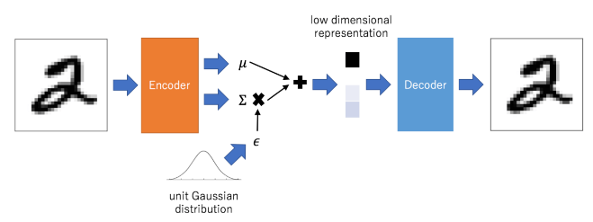
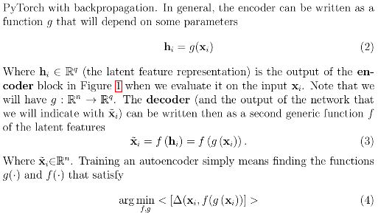
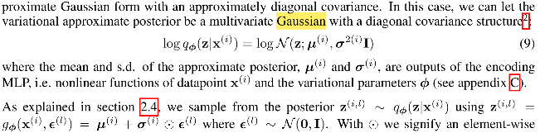
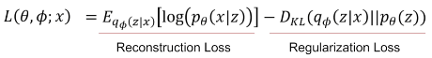
AutoEncoder (AE)
Variational AutoEncoder (VAE)

Slide 13

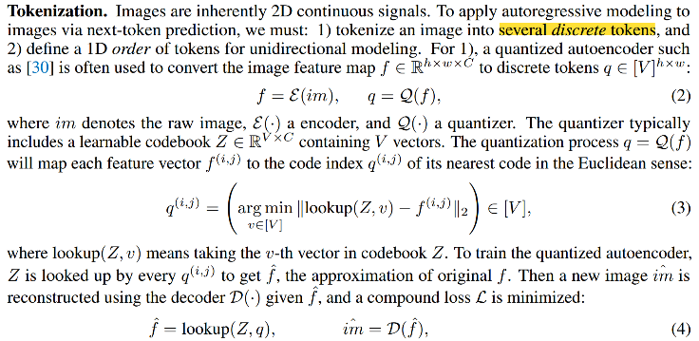
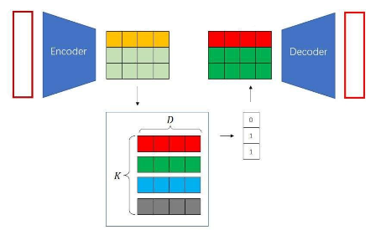
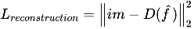
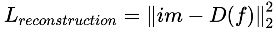
VQ-VAE (Vector Quantized Variational Autoencoder)
Motivation:
The encoder network outputs discrete, rather than continuous;
The prior is learnt rather than static.
Continuous → discrete → Continuous
For Encoder & Decoder
For codebook
For encoder
Forward:
Backward:

Slide 14
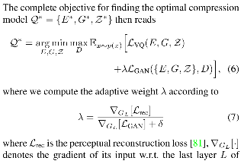
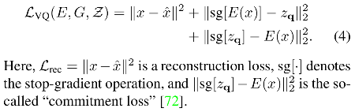
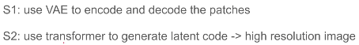
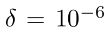
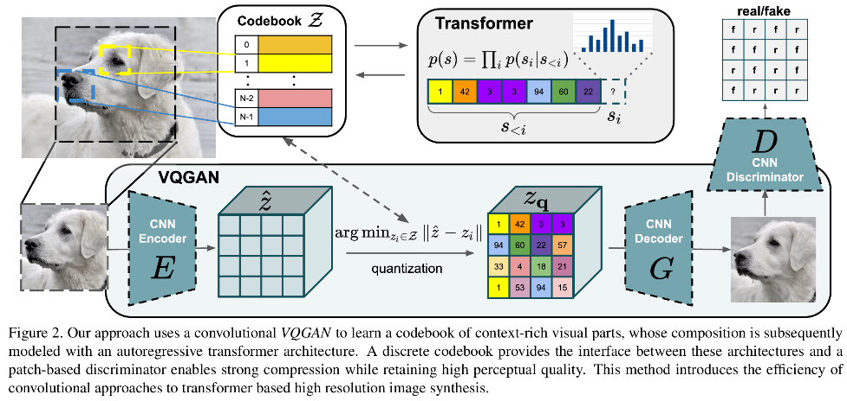
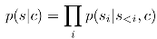
VQ-VAE + GAN(VQGAN)

Slide 15
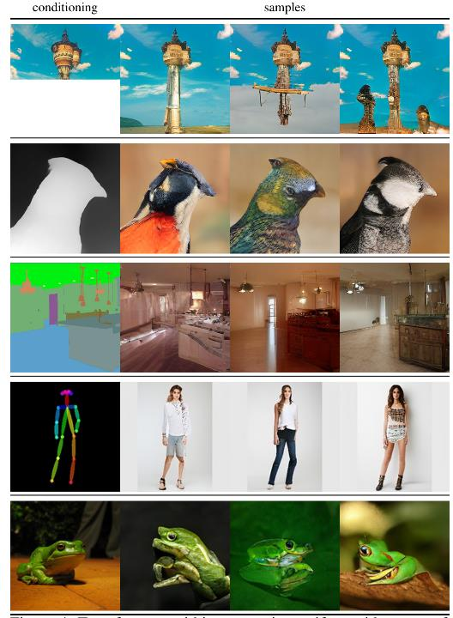
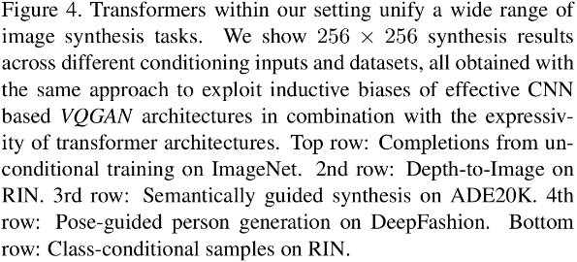

Slide 16
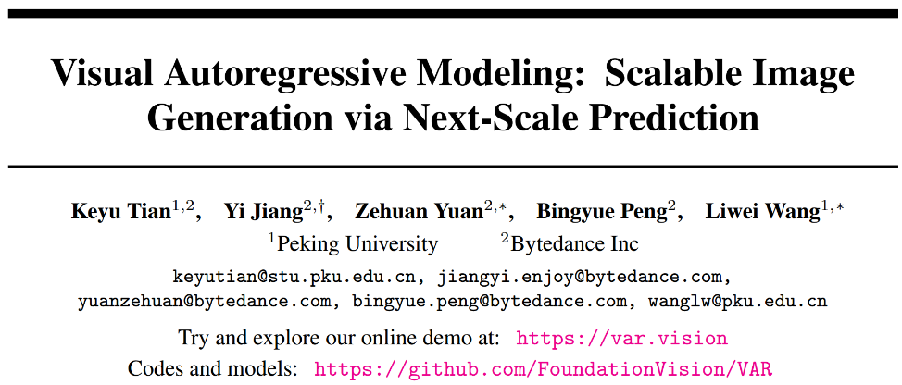
NeurIPS 2024 Best Paper (7888)

Slide 17
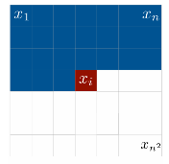
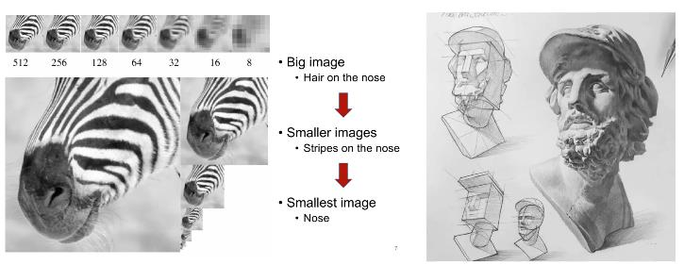
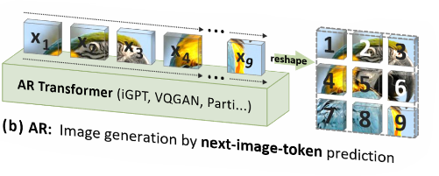
Motivation: Our work reconsiders how to ''order'' an image: Humans typically perceive or
create images in a hierachical manner, first capturing the global structure and then local details. This multi-scale, coarse-to-fine nature suggests an ''order'' for images.
Pixel-based Models
Token-based Models.

Slide 18
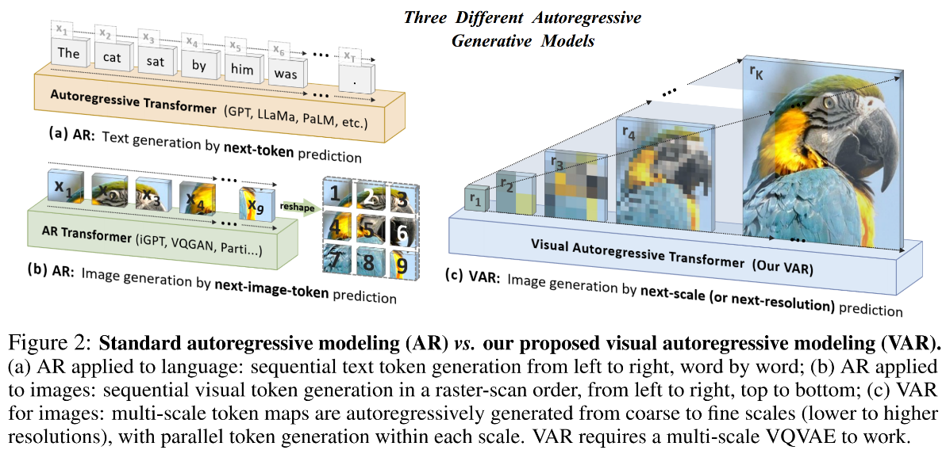

Slide 19
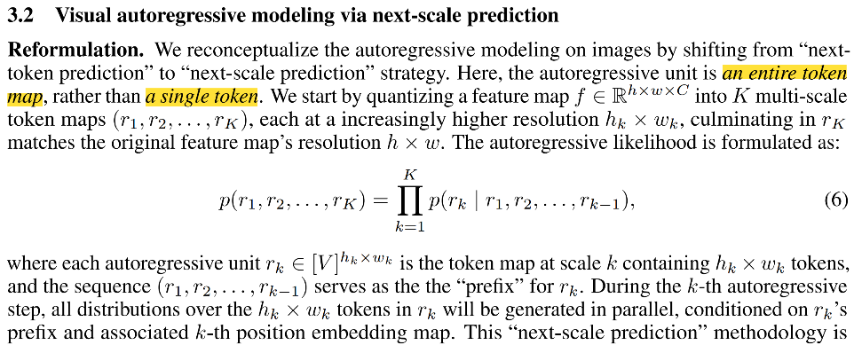

Slide 20
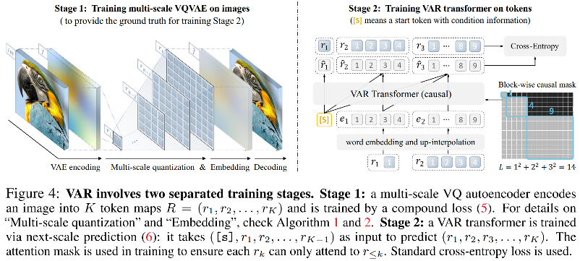
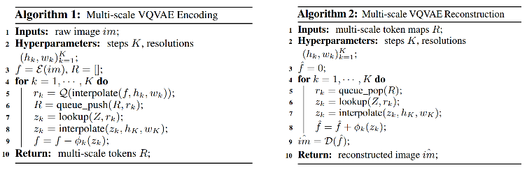



Slide 21


Slide 22



Slide 23


Slide 24

MaskGiT

Slide 25




MaskGiT

Slide 26



Slide 27


Slide 28


Slide 29



Slide 30


Slide 31


Slide 32

ArXiv 2024/10

Slide 33

Motivation: We introduce MarDini, a new family of video diffusion models that integrate the advantages of masked auto-regression (MAR) into a unified diffusion model (DM) framework. Here, MAR handles temporal planning, while DM focuses on spatial generation in an asymmetric network.

Slide 34


Slide 35


Slide 36


Slide 37


Slide 38


Slide 39


Slide 40






Slide 41


Slide 42


Slide 43


Slide 44


Slide 45
Appendix
[1] Pixel Recurrent Neural Networks(PixelCNN). ICML 2016.
[2] Neural Discrete Representation Learning(VQVAE). NeurIPS 2017.
[3] Autoregressive Models in Vision: A Survey. ArXiv 2024.
[4] Visual Autoregressive Modeling: Scalable Image Generation via Next-Scale Prediction(VAR).
NeurIPS 2024.
[5] Autoregressive Image Generation using Residual Quantization(VQ-GAN). CVPR 2022.
[6] MaskGIT: Masked Generative Image Transformer(MaskGIT). CVPR 2022.
[7] MarDini: Masked Autoregressive Diffusion for Video Generation at Scale (MarDini). ArXiv 2024.

Slide 46
Visual Autoregressive Model

Slide 47
THANKS

